Slide 1

Sauce & Spoon
Tablet Rollout
Impact Report

Slide 2
Executive Summary
The purpose of the project was to install the table tablets in two locations in order to determine their effectiveness to help the Sauce and Spoon achieve the customer satisfaction and revenue goals as laid out by the senior staff.
The project accomplished two important milestones that contributed to the goals:
Increased customer satisfaction: our customer satisfaction rates increased from 72% to 88%.
Increased sales: monthly revenue has increased by 20% since the September tablet rollout.
The project also provided lessons learned that we can adopt for future projects:
Forecast for unforeseen delays: the storm delayed our implementation by two months we need to have several contingent action plans.
Commit toon-going refresher training: Our staff did a great job but with tablet upgrades and turnover we need to have scheduled training sessions (quarterly basis).
This phase of the project is complete the next phase will highlight:
Implement tablets in more locations: Create new project plan for new location installation (Q2).
Continue to track customer experience and satisfaction: Continue surveying/gathering data through various means (on-going).

Slide 3
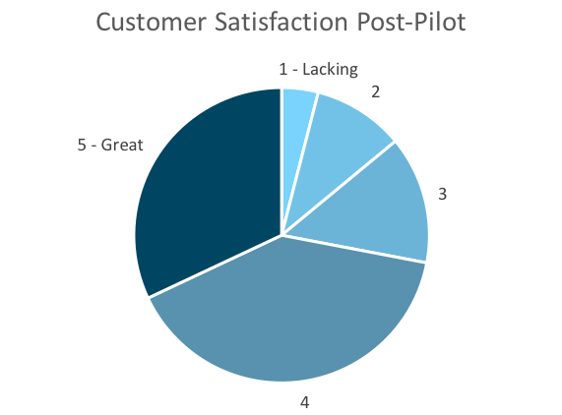
Customer Satisfaction: Pilot
Q. On a scale of 1-5, please rate your experience with the tablet overall.
This pie chart illustrates the results from the post-pilot survey.
72% of respondents indicated a customer satisfaction score of 4 or 5.
Notes:
First pie chart: Results from the post-pilot survey
Second pie chart: Results from the post-launch survey, after making changes
Satisfaction has gone up from 72% (4 and 5 rating) to 86% (4 and 5 rating)
Post-pilot data:
1 - Lacking 2 4%
2 5 10%
3 7 14%
4 20 40%
5 - Great 16 32%
Post-launch data:
1 - Lacking 1 2%
2 2 4%
3 4 8%
4 22 44%
5 - Great 21 42%

Slide 4
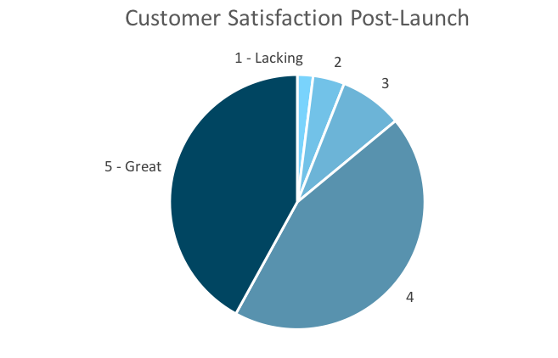
Customer Satisfaction: Launch
Q. On a scale of 1-5, please rate your experience with the tablet overall.
This pie chart illustrates the results from the post-launch survey.
86% of respondents indicated a customer satisfaction score of 4 or 5. This is a 19% increase.
Notes:
First pie chart: Results from the post-pilot survey
Second pie chart: Results from the post-launch survey, after making changes
Satisfaction has gone up from 72% (4 and 5 rating) to 86% (4 and 5 rating)
Post-pilot data:
1 - Lacking 2 4%
2 5 10%
3 7 14%
4 20 40%
5 - Great 16 32%
Post-launch data:
1 - Lacking 1 2%
2 2 4%
3 4 8%
4 22 44%
5 - Great 21 42%

Slide 5
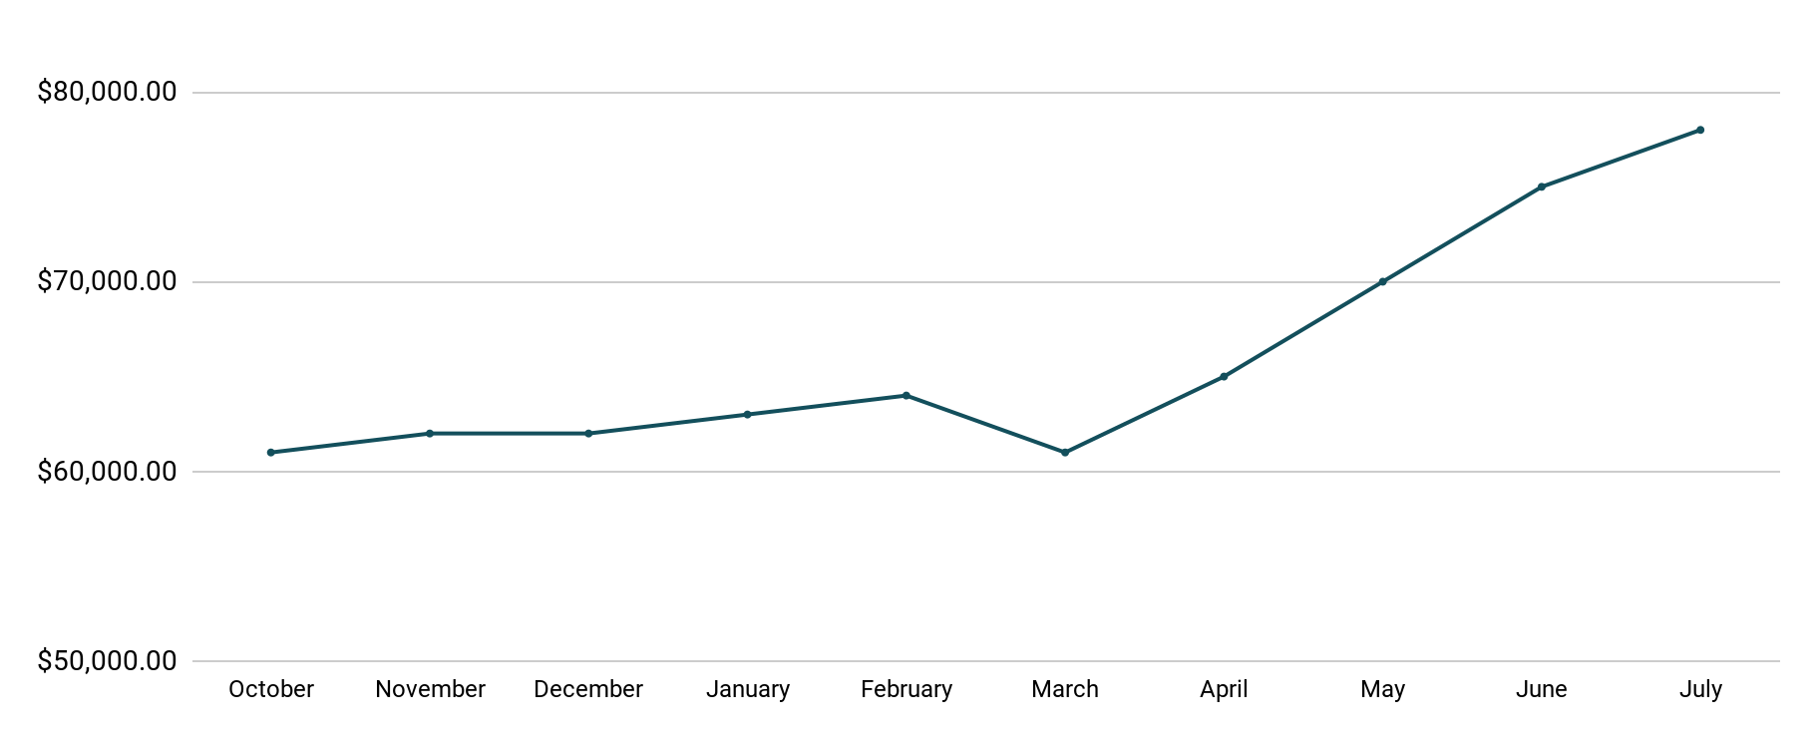
Revenue
Tablet Launch April 23
This is a chart of Sauce & Spoon revenue, showing that after tablet implementation, revenue increased.
July revenue was up to 20% over April’s monthly revenue.
Notes:
This is a chart of Sauce & Spoon revenue, showing that after tablet implementation, revenue increased. December revenue was up to 20% over September’s monthly revenue.
Sales data:
October
$61,000.00
November
$62,000.00
December
$62,000.00
January
$63,000.00
February
$64,000.00
March
$61,000.00
April
$65,000.00
May
$70,000.00
June
$75,000.00
July
$78,000.00

Slide 6
What Worked: Key Accomplishments
Decreased table turn time
Implementation of the tablets increased the average daily guest count by 10%.
Tablets also decreased wait time by 30 minutes.
Decreased food waste
Tablets identified who was receiving an incorrect order.
Kitchen staff has taken the initiative to correct orders and decrease food waste by 50%.
Increased customer satisfaction
After the pilot, customer satisfaction was at 72%.
Once we implemented improvements based on feedback, customer satisfaction increased to 86%.
Increased sales
Our monthly revenue has increased steadily since the tablet rollout, upwards of 20% since September/pre-rollout.
Tablets also helped boost revenue during the holiday season.

Slide 7
Next Steps: Looking Forward
Initiative | Action | Date
Implement tablets in more locations | Create new project plan for new location installation | Q2
Continue to track customer experience and satisfaction | Continue surveying/ gathering data through various means | Ongoing
Expand tablet features | Investigate new features like social media integration, reservations, videos, etc. | Q4

Slide 8
Appendix
Access all resources here.
Notes:
Insert link to your shared drive or a shared folder with all of the relevant project artifacts

